Slide 1
Cellcounter User Manual
“Neuron localization and counting” – Tamal Batabyal, Aijaz Naik, Daniel Weller, Jaideep Kapur

Slide 2
Download the package from Github
Click here:
Linux : cellCountingPackage_Linux
Windows: cellCountingPackage_Windows

Slide 3
Required packages to run Cellcounter
Anaconda : https://repo.anaconda.com/archive/ (Python – 3.5 or 3.6)
Pytorch : https://pytorch.org/get-started/locally/ (check the next slide)
Scipy : https://anaconda.org/anaconda/scipy
Skimage : https://anaconda.org/anaconda/scikit-image
OpenCV: https://anaconda.org/anaconda/opencv
or
http://web.cecs.pdx.edu/~fliu/courses/cs410/python-opencv.html
Torchsummary: Open Anaconda Prompt. Type “pip install torchsummary”. Then hit ENTER
MATLAB

Slide 4
Pytorch
Windows + CUDA 10.2 + Conda
Linux + CUDA 10.2 + Conda
Windows + No CUDA + Conda
Linux + No CUDA + Conda
Which version : CUDA 10.1 or 10.2 or else?? Depends on your NVIDIA driver.
Check the table : https://docs.nvidia.com/deploy/cuda-compatibility/index.html
conda install pytorch torchvision torchaudio cudatoolkit=10.2 -c pytorch
conda install pytorch torchvision torchaudio cudatoolkit=10.2 -c pytorch
conda install pytorch torchvision torchaudio cpuonly -c pytorch
conda install pytorch torchvision torchaudio cpuonly -c pytorch

Slide 5
CUDA packages compatibility problem
>> Check driver : modinfo nvidia|grep version
>> Delete current Nvidia driver: sudo apt-get purge nvidia*
>> Check driver: modinfo nvidia|grep version (You will see no nvidia driver)
>> Look for Nvidia driver: apt search nvidia-driver
>> Install : sudo apt install nvidia-driver-440 check which driver number is compatible.)
>>>> If you see "sudo apt-get check failed" first "Delete current Nvidia driver". Then run sudo dpkg-reconfigure libdvd-pkg. Next, start from "Check driver"
>> sudo reboot
>> sudo apt-get update
>> sudo apt-get upgrade
>> sudo reboot (twice)
>> conda update conda
>> conda update spyder
>> spyder (type it at the Anaconda terminal)
>> (open Spyder) import torch
>> (in Spyder) torch.cuda.is_available()
CUDA version upgraded with NVIDIA driver. Check here
https://docs.nvidia.com/deploy/cuda-compatibility/index.html

Slide 6
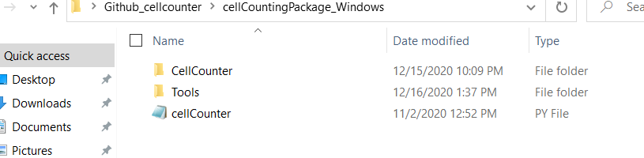
Windows version
Download the “CellCountingPackage_Windows” package to Desktop.

Slide 7
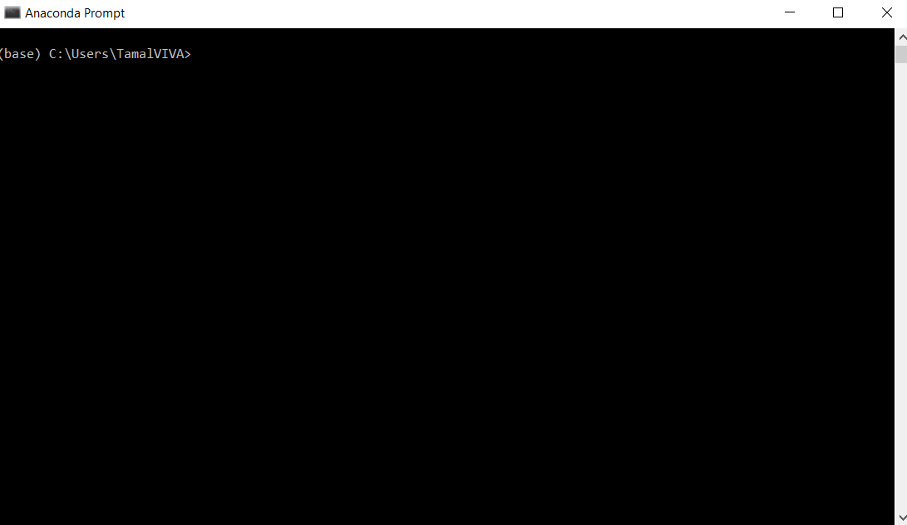
Windows version
Open Anaconda prompt by using Windows search.

Slide 8
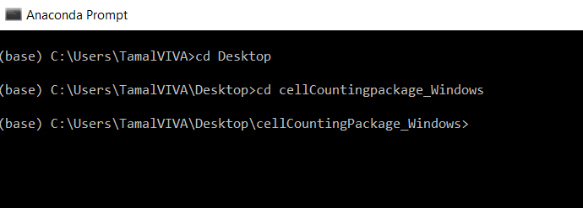
Windows version
Type the following
>> cd Desktop (hit ENTER)
>> cd cellCountingPackage_Windows (hit ENTER)

Slide 9
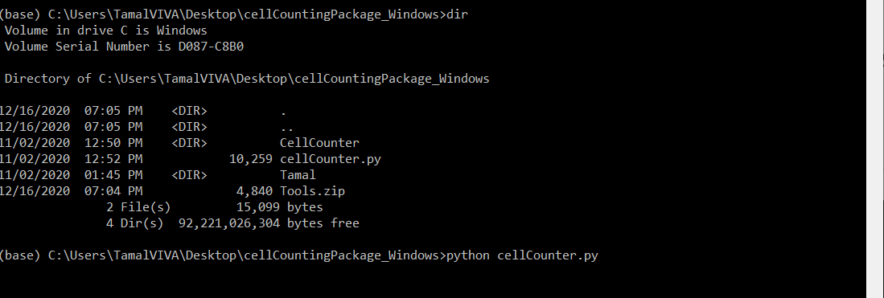
Windows version

Slide 10
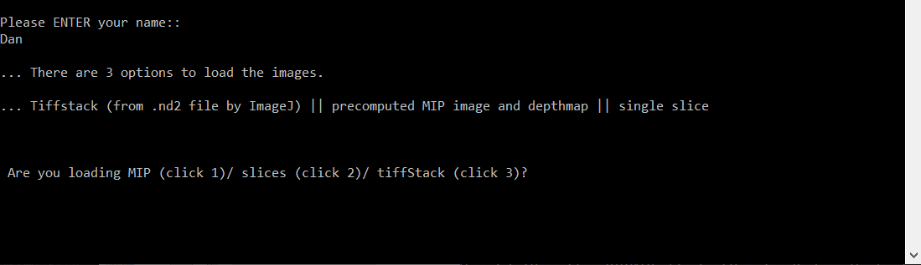
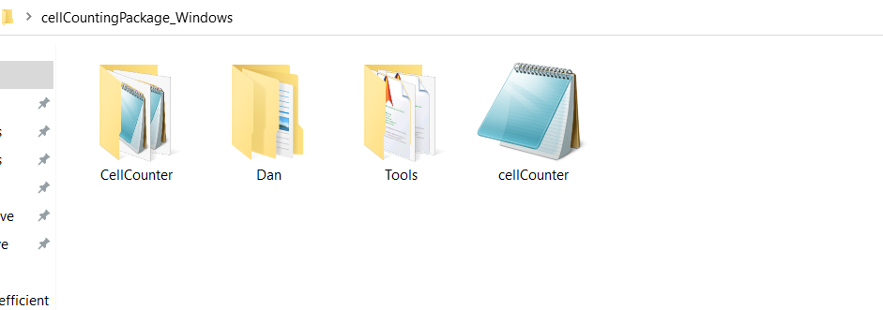
Windows version
Next slide
Once you type your name, (in this case, it is Dan), Please go to the cellCountingPackage_Windows at the Desktop.
You will see a folder by your name

Slide 11
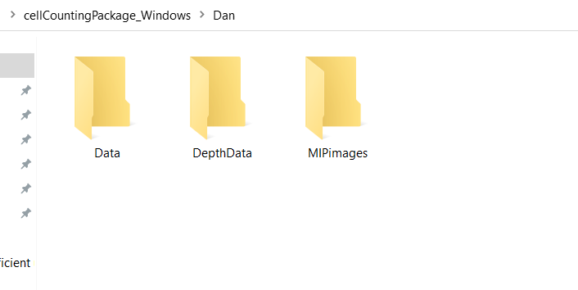
Windows version
Inside Dan, there are the following folders
Option 1
Use ImageJ to extract channel and z-images. Place all the images into a folder. Place that folder inside Data.
Cellcounter will count Maximum Intensity Projection image and internally send that MIP image to ‘MIPimages’ folder. In addition, Cellcounter sends the ‘Z’ matrix (what depth a pixel has maximum) to ‘DepthData’ folder.
IF you have z-stack images, Type 1 (click 3) and hit ENTER.
Option 2
This folder is for slice/image/MIP images. Images MUST be in .tif format and gray-valued.
If you have Z-stack images, USE createMIPwithoutZ.m (provided in the ‘Tools’ folder inside cellcounting package) to get an MIP image beforehand.
Type 2 (click 2) and hit ENTER.
Check Prepocessing.pptx before moving
onto the next slide.

Slide 12
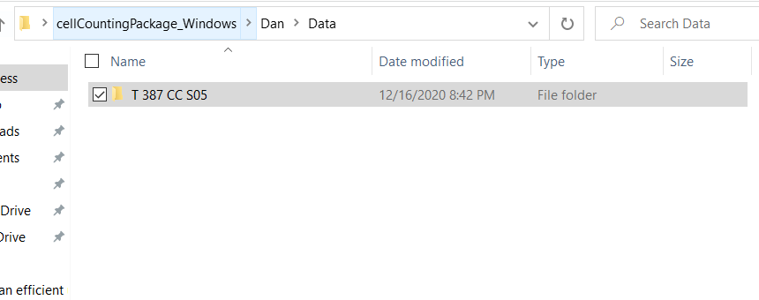
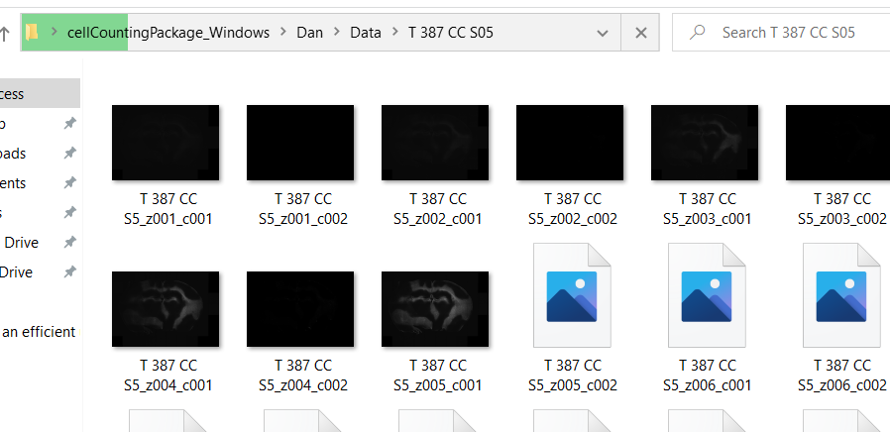
Windows version
Option 1
Z stack images are in ‘T 387 CC S05’, which is placed inside ‘Data folder’.
Channel
‘c001’, ’c002’
Z values

Slide 13
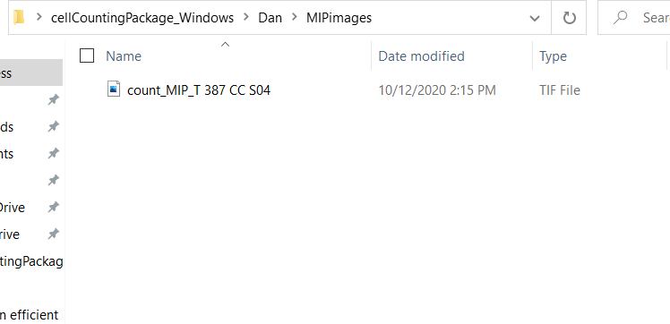
Windows version
Option 2
MIP images are placed in ‘MIPimages’ folder.

Slide 14
Either Option 1 or Option 2
Option 2
Option 1

Slide 15
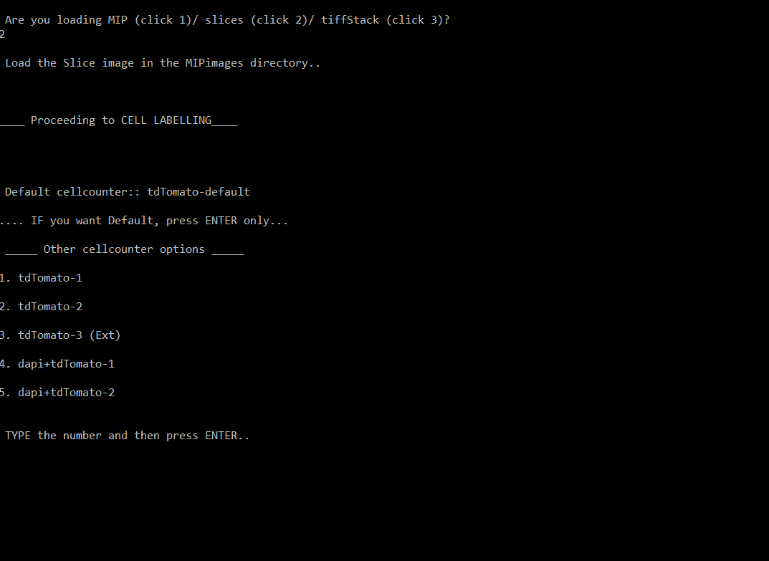
Windows version
2 : means there are MIP images or
slices in the MIPimages directory.
You will see options corresponding
to different stainings or transgenic
expressed neurons.
Such as tdTomato, NeuN etc.
The default is tdTomato.
For default press 0 and then ENTER.

Slide 16
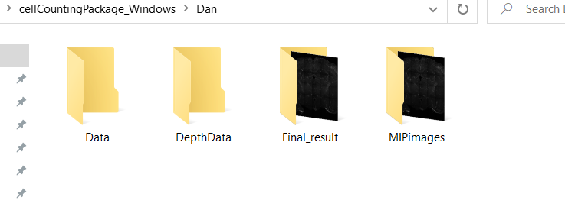
Windows version
Congrats…!! YOU ARE DONE.
The labeled-images will be ready in the ‘Final_result’ folder inside
User’s (in this case Dan) folder.

Slide 17
How to count
The neurons in the images will be labeled by the Cellcounter.
Next, region-based counting

Slide 18
How to count
Open the folder ‘Tools’ inside cellCounterPackage_Windows.
There is a MATLAB script drawANDcount.m
Double click on it. MATLAB will be opened.

Slide 19
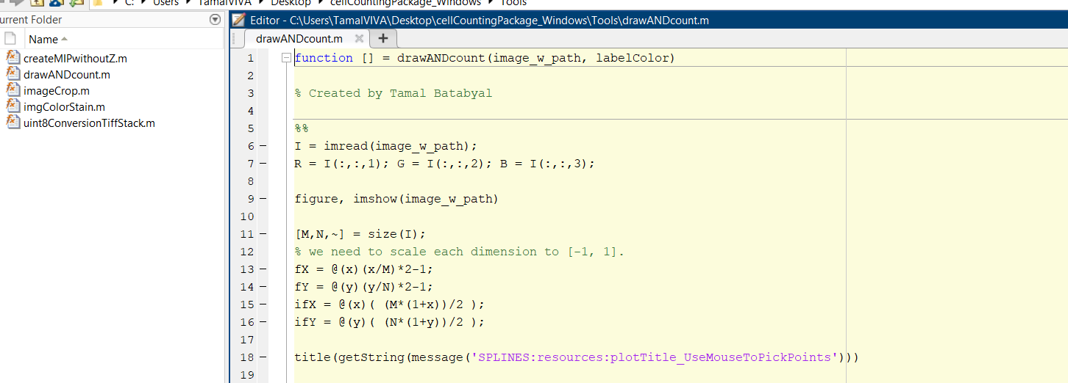
How to count

Slide 20
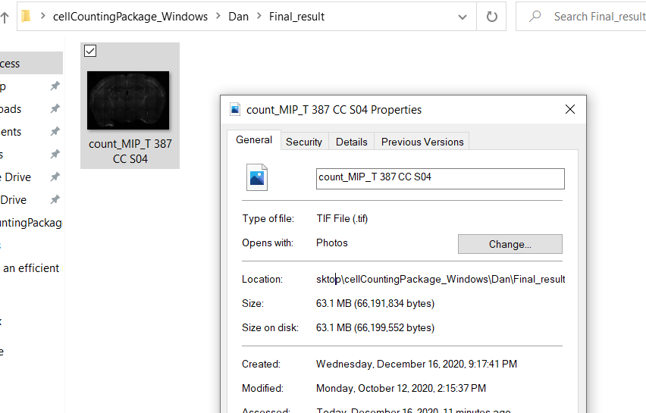
How to count
Remember The LABELED images are in
the “Final_result” folder inside ‘Dan’
(user folder).
In this case there is only one labeled image
Copy the location

Slide 21
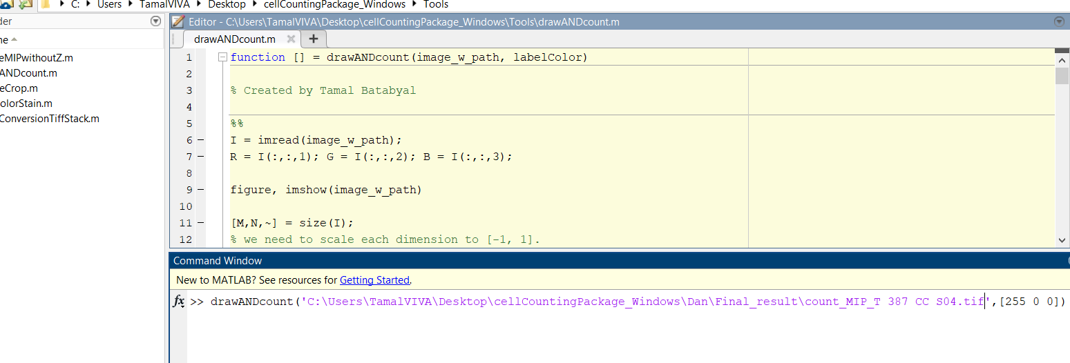
How to count
Labeled image with .tif
Color::
Neuron
Cell body
Is labeled
w red
TYPE this
Copied location
Now hit ENTER

Slide 22
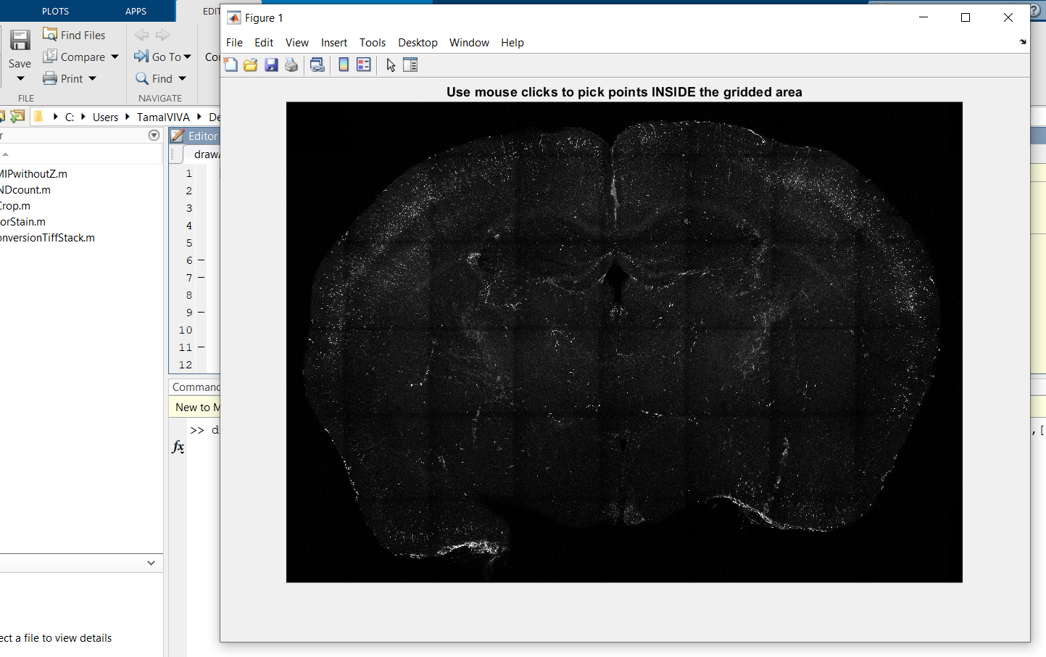
How to count
The labeled image will appear

Slide 23

How to count
Zoom tools
+ : zoom in
- : zoom out
Hand tool
Navigate to your region of interest
using the hand tool and zoom tool

Slide 24
How to count
Zoom tools
Hand tool
Navigate to your region of interest
using the hand tool and zoom tool
Once you navigate to your region of interest, Hit the SPACE bar.
You will notice a change in the cursor, changing from a small white one to a large black one

Slide 25
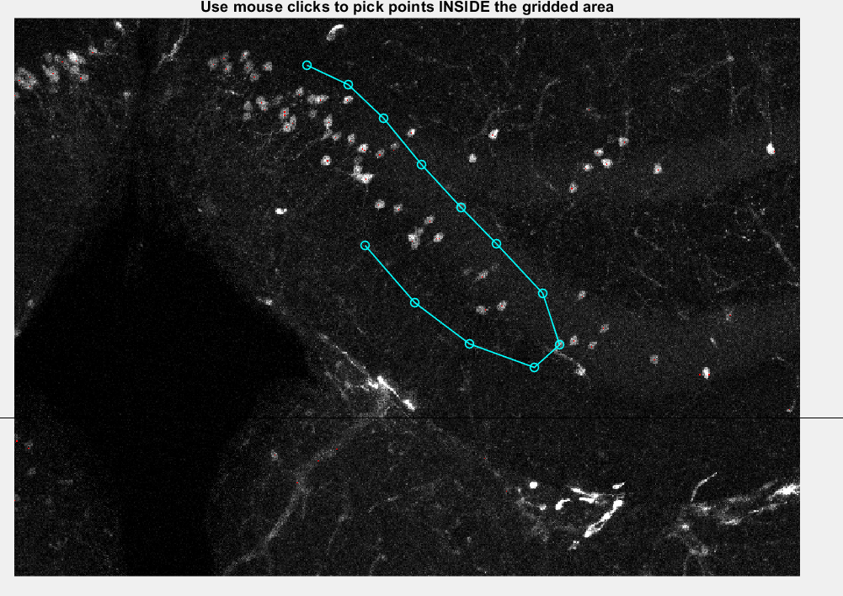
How to count
Click points to make a boundary.
You will notice that once you click a
Point, it will be automatically
joined to the previous
Point with a line.

Slide 26
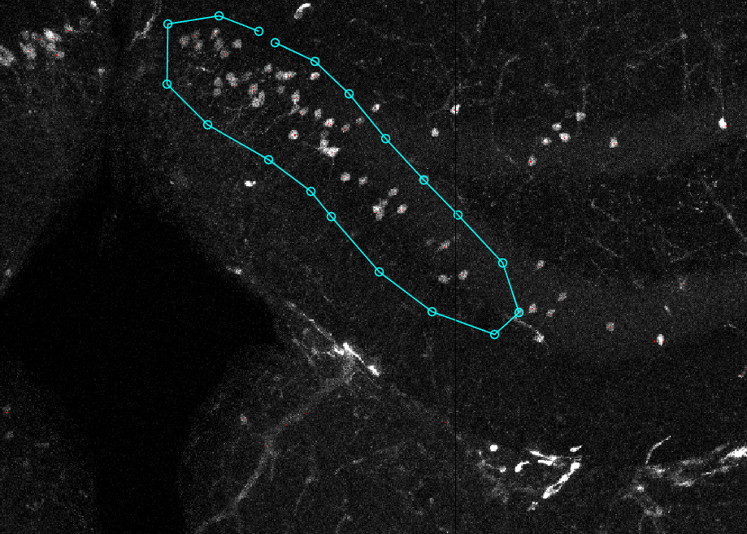
How to count
Once you are DONE,
If you hit SPACE bar again,
It will zoom out and allow
You to SELECT another region.
If you hit ENTER, it will zoom out
and you can not select a region
anymore. The selected regions
will be displayed
You don’t need to mount the LAST point on the FIRST one.
They will be joined automatically once you hit the
SPACE/ENTER button.

Slide 27
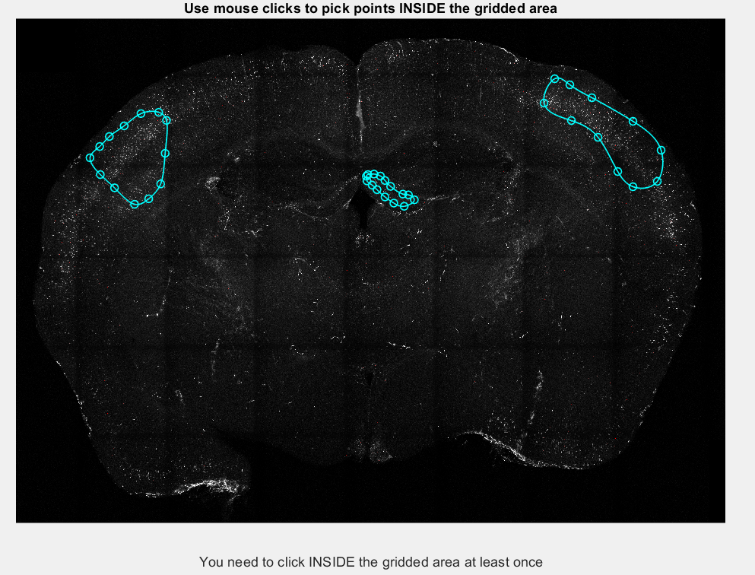
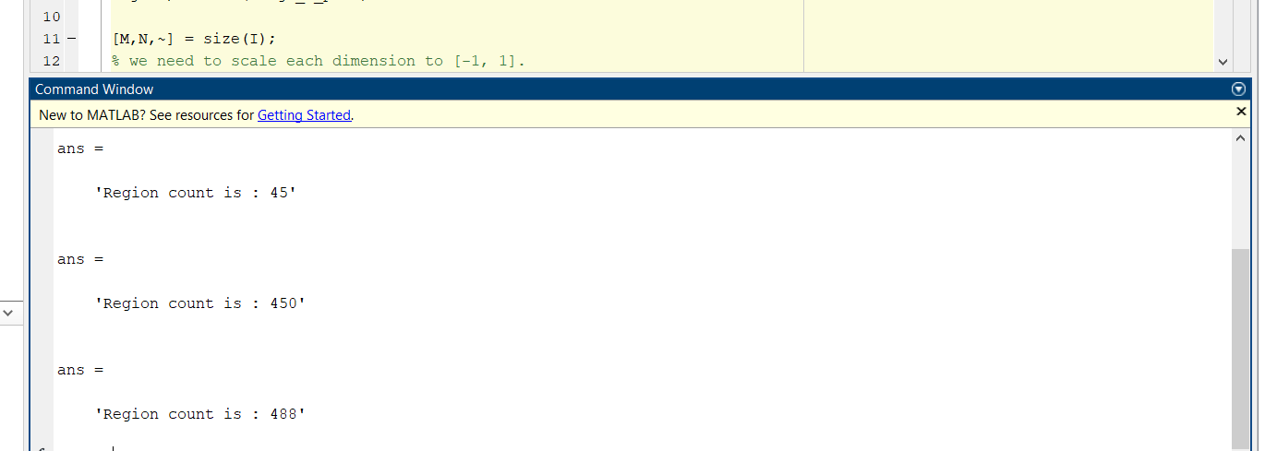
How to count
Here I selected three regions
You will notice the smoothness of
Each enclosing contour, because it is a Bezier curve.
The number of neurons in
each region is displayed
in the Command Window
of MATLAB

Slide 28
Upcoming
More staining specific/transgenic expression options of Cellcounter configurations – Fluoro-Jade, c-Fos, Arc
More image-quality specific options of Cellcounter configurations – Fluoro-Jade, c-Fos, Arc.

